Slide 1

CapStone Project
Body Pose Estimation

Slide 2
Body Pose Estimation Approach
MediaPipe powers the ML in many Google products, and it's open source to help you to bring
cutting-edge, performant, and scalable features to your customers.
Human Pose estimation is a computer vision task that represents the orientation of a person in a
graphical format. This technique is widely applied to predict a person’s body parts or joint
position. It is one of the most exciting areas of research in computer vision that has gained a lot
of traction because of its abundance of applications that can benefit from such a technology
The MediaPipe Pose Landmarker task lets you detect landmarks of human bodies in an image or
video. You can use this task to identify key body locations, analyze posture, and categorize
movements. This task uses machine learning (ML) models that work with single images or video.

Slide 3
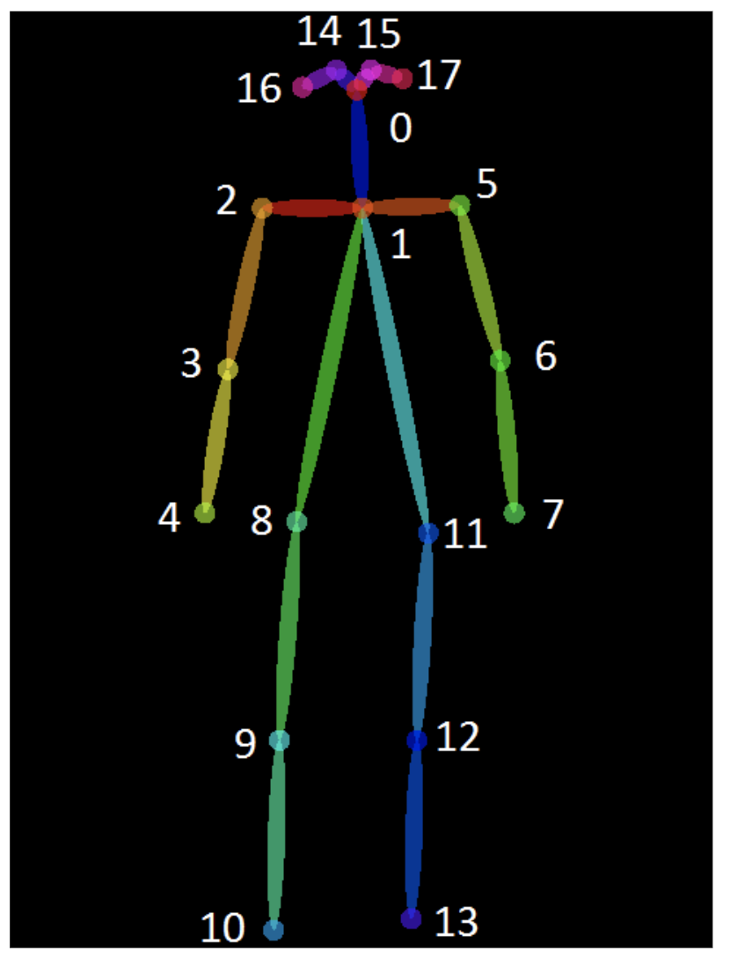
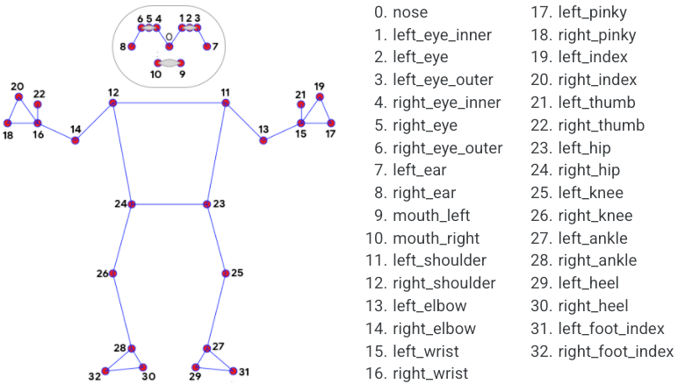
Landmarks

Slide 4
Body Pose Algorithm (1/3)
1. Importing Libraries:
cv2 (OpenCV): For image processing and computer vision tasks.
mediapipe: For pose estimation in images.
os: For handling directory creation.
datetime: For timestamping.
pandas: For creating and saving data in an Excel file.
glob: For reading image files from a directory.
2. Setting Up Folders:
image_folder: Path to the folder containing images to be processed.
output_folder: Path to the folder where results (images with detected activities) will be saved.
os.makedirs: Ensures the output folder exists, creating it if necessary.

Slide 5
Body Pose Algorithm (2/3)
3.MediaPipe Pose Estimation Setup:
Initializes MediaPipe's pose estimation tools.
4. Defining Suspicious Activity Criteria:is_suspicious_activity:
A function that defines what constitutes suspicious activity. In this case, it checks if the y-coordinate of the
left wrist is above a certain threshold compared to the y-coordinate of the nose, indicating the wrist is higher than the head.
5. Processing Each Image in the Folder:
The script iterates through each .jpg image file in image_folder.For each image, it converts the image to RGB, processes it with MediaPipe to find pose landmarks, and then checks for suspicious activity. If suspicious activity is detected, the image is saved to the output_folder, and a log entry is created.

Slide 6
Body Pose Algorithm (3/3)
6. Drawing Landmarks:
For each detected pose landmark, a circle is drawn on the image for visualization.
7. Logging and Saving Results:
For each image, details such as the image name, timestamp, and whether suspicious activity was detected are appended to log_data.After processing all images, log_data is converted to a Pandas DataFrame and saved as an Excel file (activity_log.xlsx).

Slide 7
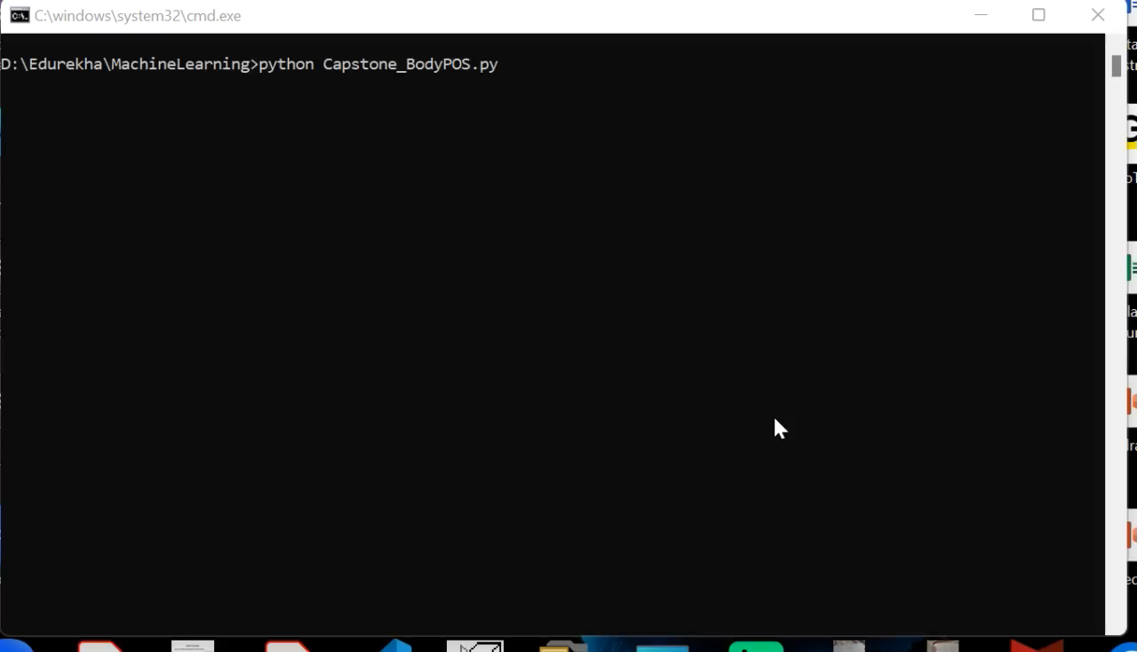
Test Result
Test Scenario : Given the Set of Images find the “Suspicious Image” with Right Hand placed behind the head.
Simulation Video :

Slide 8
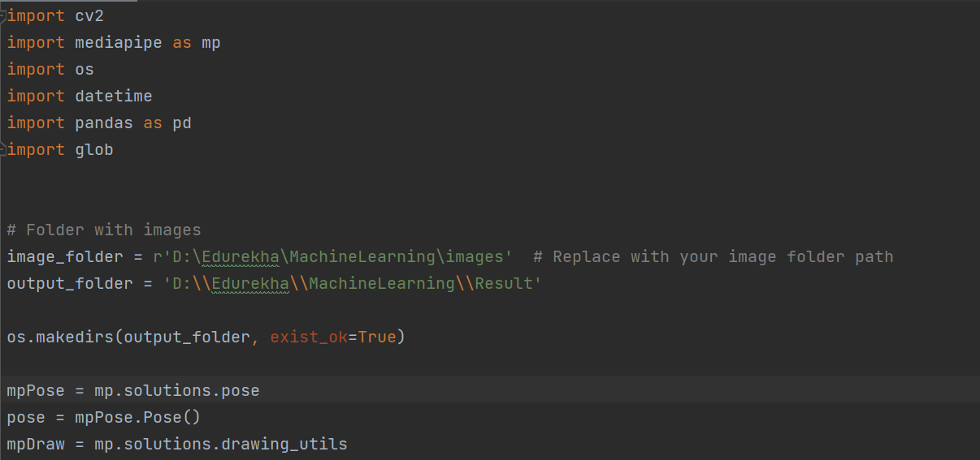
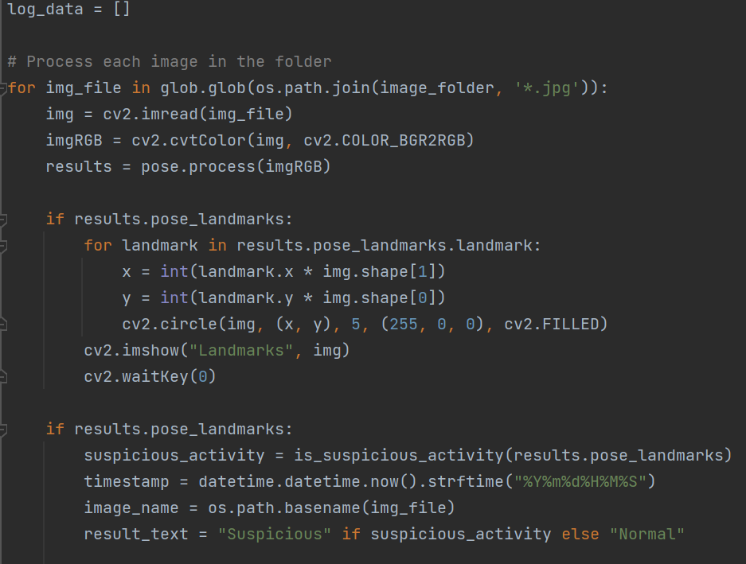
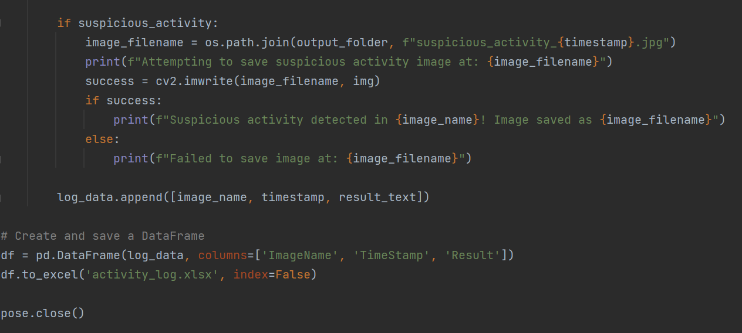
Code Explanation

Slide 9
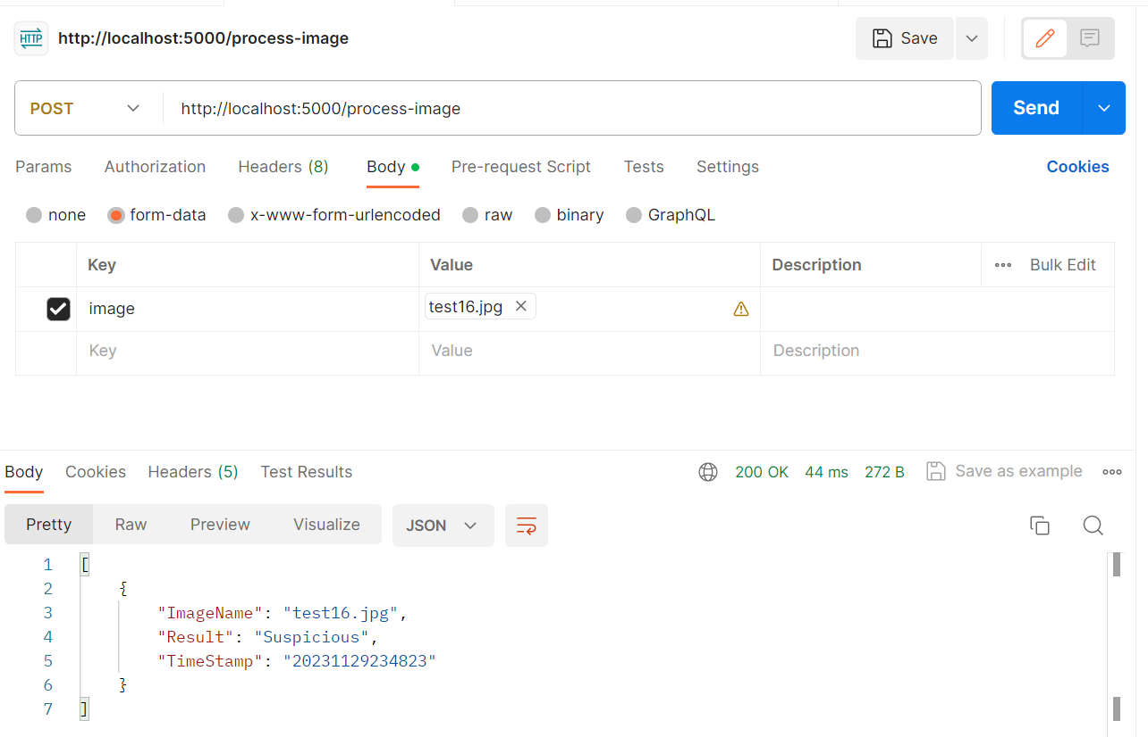
API Call using PostMan

